Slide 1
Topic: Increasing or Decreasing Percentage EQ: How do I use excel to calculate increase and decrease in percentages?
Year 11 Essentials

Slide 2
Things Required For This Lesson
Interactive Notebook
Textbook: Interleaved Maths Essential Connections
Ruler, Red Pen, Pencil, Pens, Scientific Calculator
Growth mindset

Slide 3

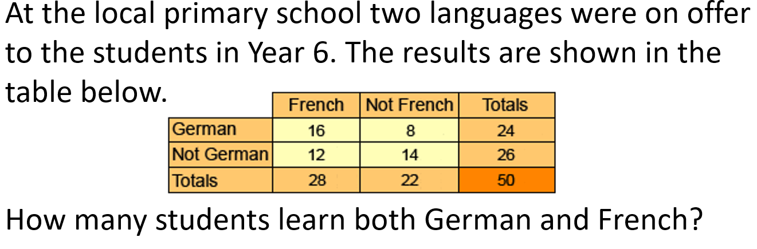
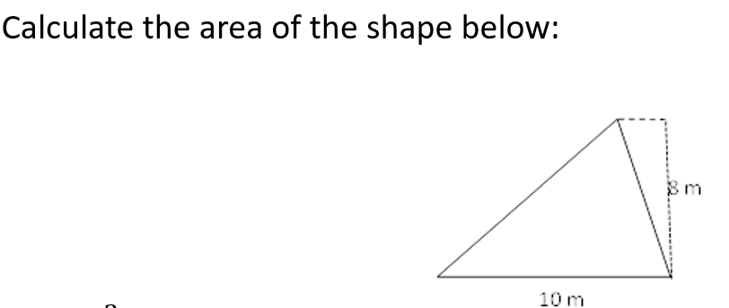


Topic: Increase and Decrease in percentages?
EQ: How do I use excel to calculate increase and decrease in percentages?
$$478+223+ =1000$$

Slide 4
Answers
1) 7 Cakes
2) 28 Students
3) 299
4) 70
5) 40 cm

Slide 5

24
7
30
Topic: Increase and Decrease in Percentages
Date: /05/2021
EQ: How do I use excel to calculate increase and decrease in percentages
WICOR

Slide 6
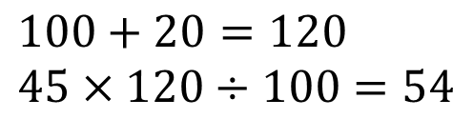
24
7
30
Topic: Increase and Decrease in Percentages
EQ: How do I use excel to calculate increase and decrease in percentages
How to increase a percentage?
To Increase by a percentage:
Add the increase to 100.
Multiply the number by this new number
Divide everything by 100.
EXAMPLE:
Increase 45 by 20%
$$100+20=120 \\ 45×120÷100=54$$
WICOR

Slide 7

24
7
30
Topic: Increase and Decrease in Percentages
EQ: How do I use excel to calculate increase and decrease in percentages
How to decrease a percentage?
To Decrease by a percentage:
Subtract the decrease from 100.
Multiply the number by this new number
Divide everything by 100.
EXAMPLE:
Decrease 45 by 20%
$$100−20=80 \\ 45×80÷100=36$$
WICOR

Slide 8
Investigate
Turn to page 56 of your Interleave Math Book and following the steps to complete a spreadsheet

Slide 9

Thank you
Keep up the good work!
“There comes a day where you’re gonna look around and realise happiness is where you are.”
-A.A Milne

